Slide 2
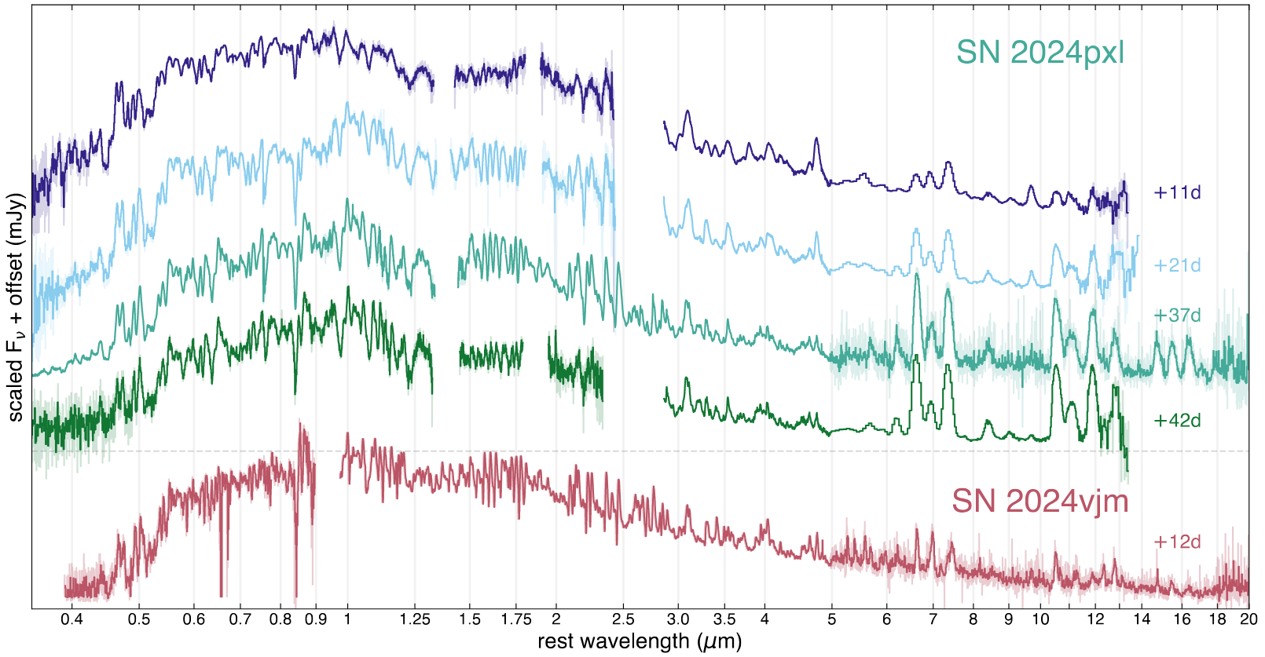
Forbidden (optically thin) emission lines from interior
Photospheric (optically thick) P-Cygni profiles from outer layers

Slide 3
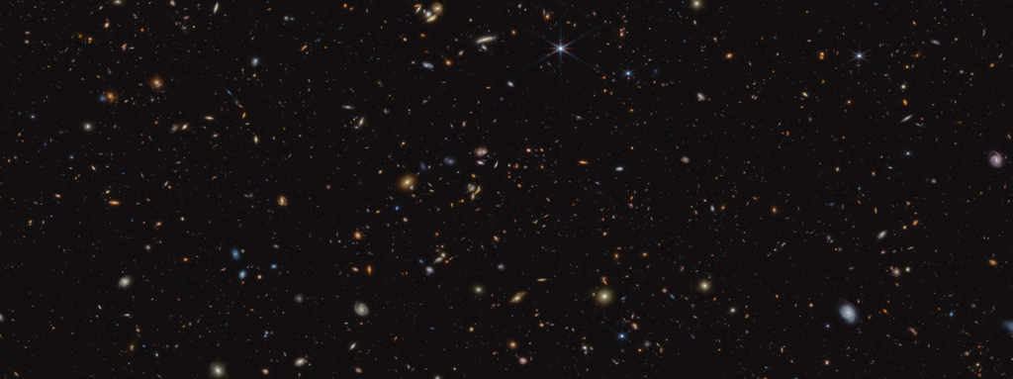
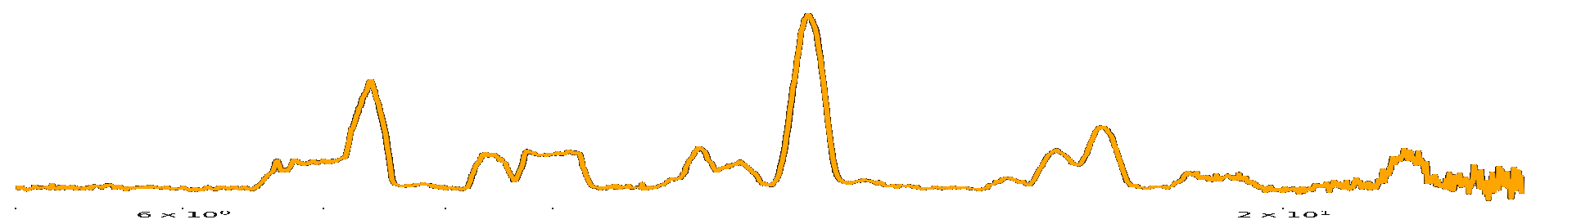
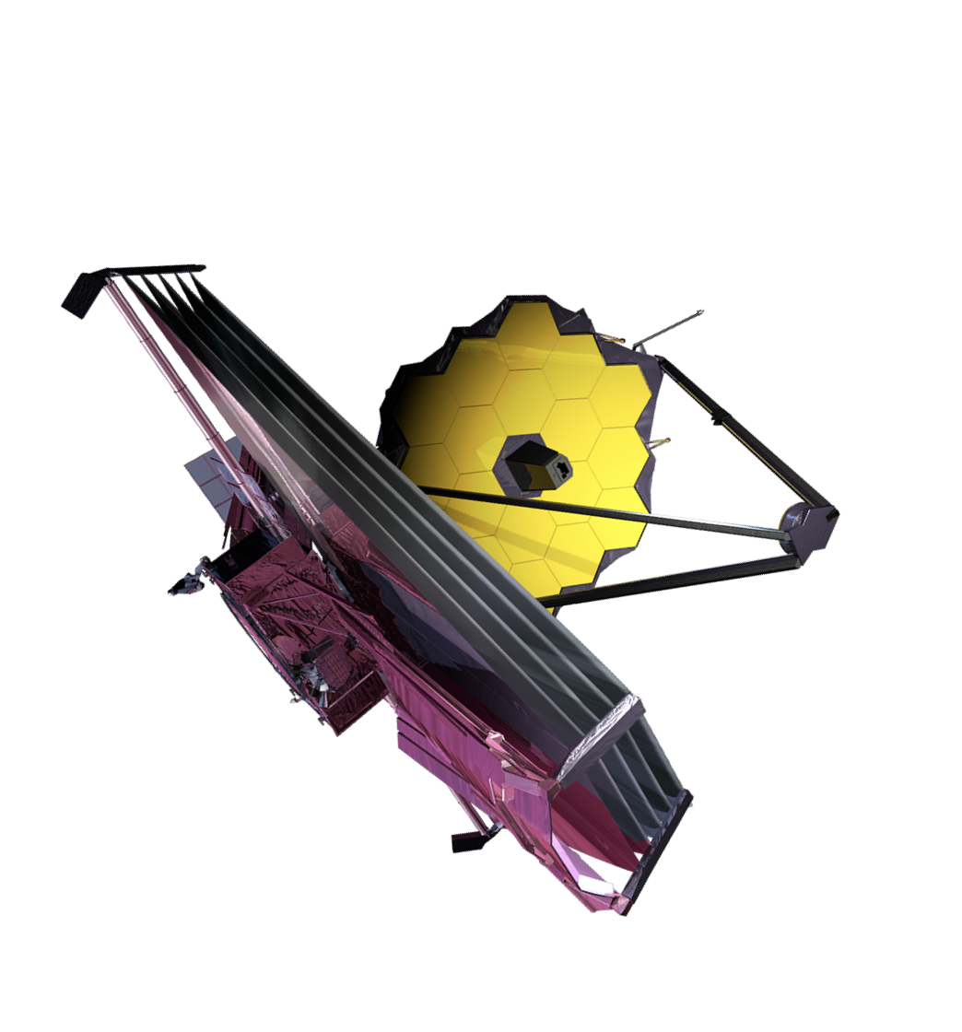
Exploding White Dwarfs in a New Light
💥

Slide 4

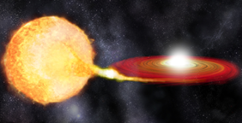
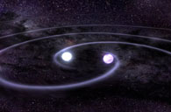

Slide 5

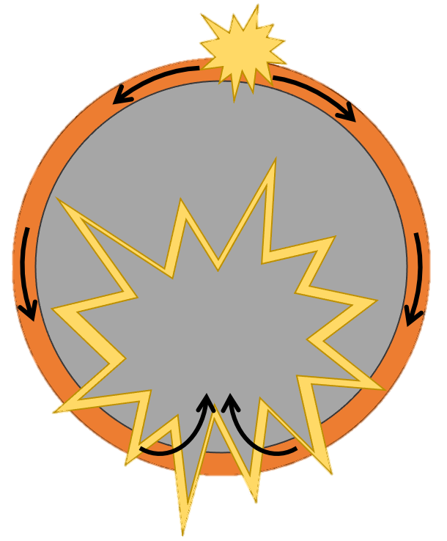



Slide 6
Only the violent merger model predicts strong, central [Ne II]
peculiar SN Ia
normal SN Ia

Slide 7
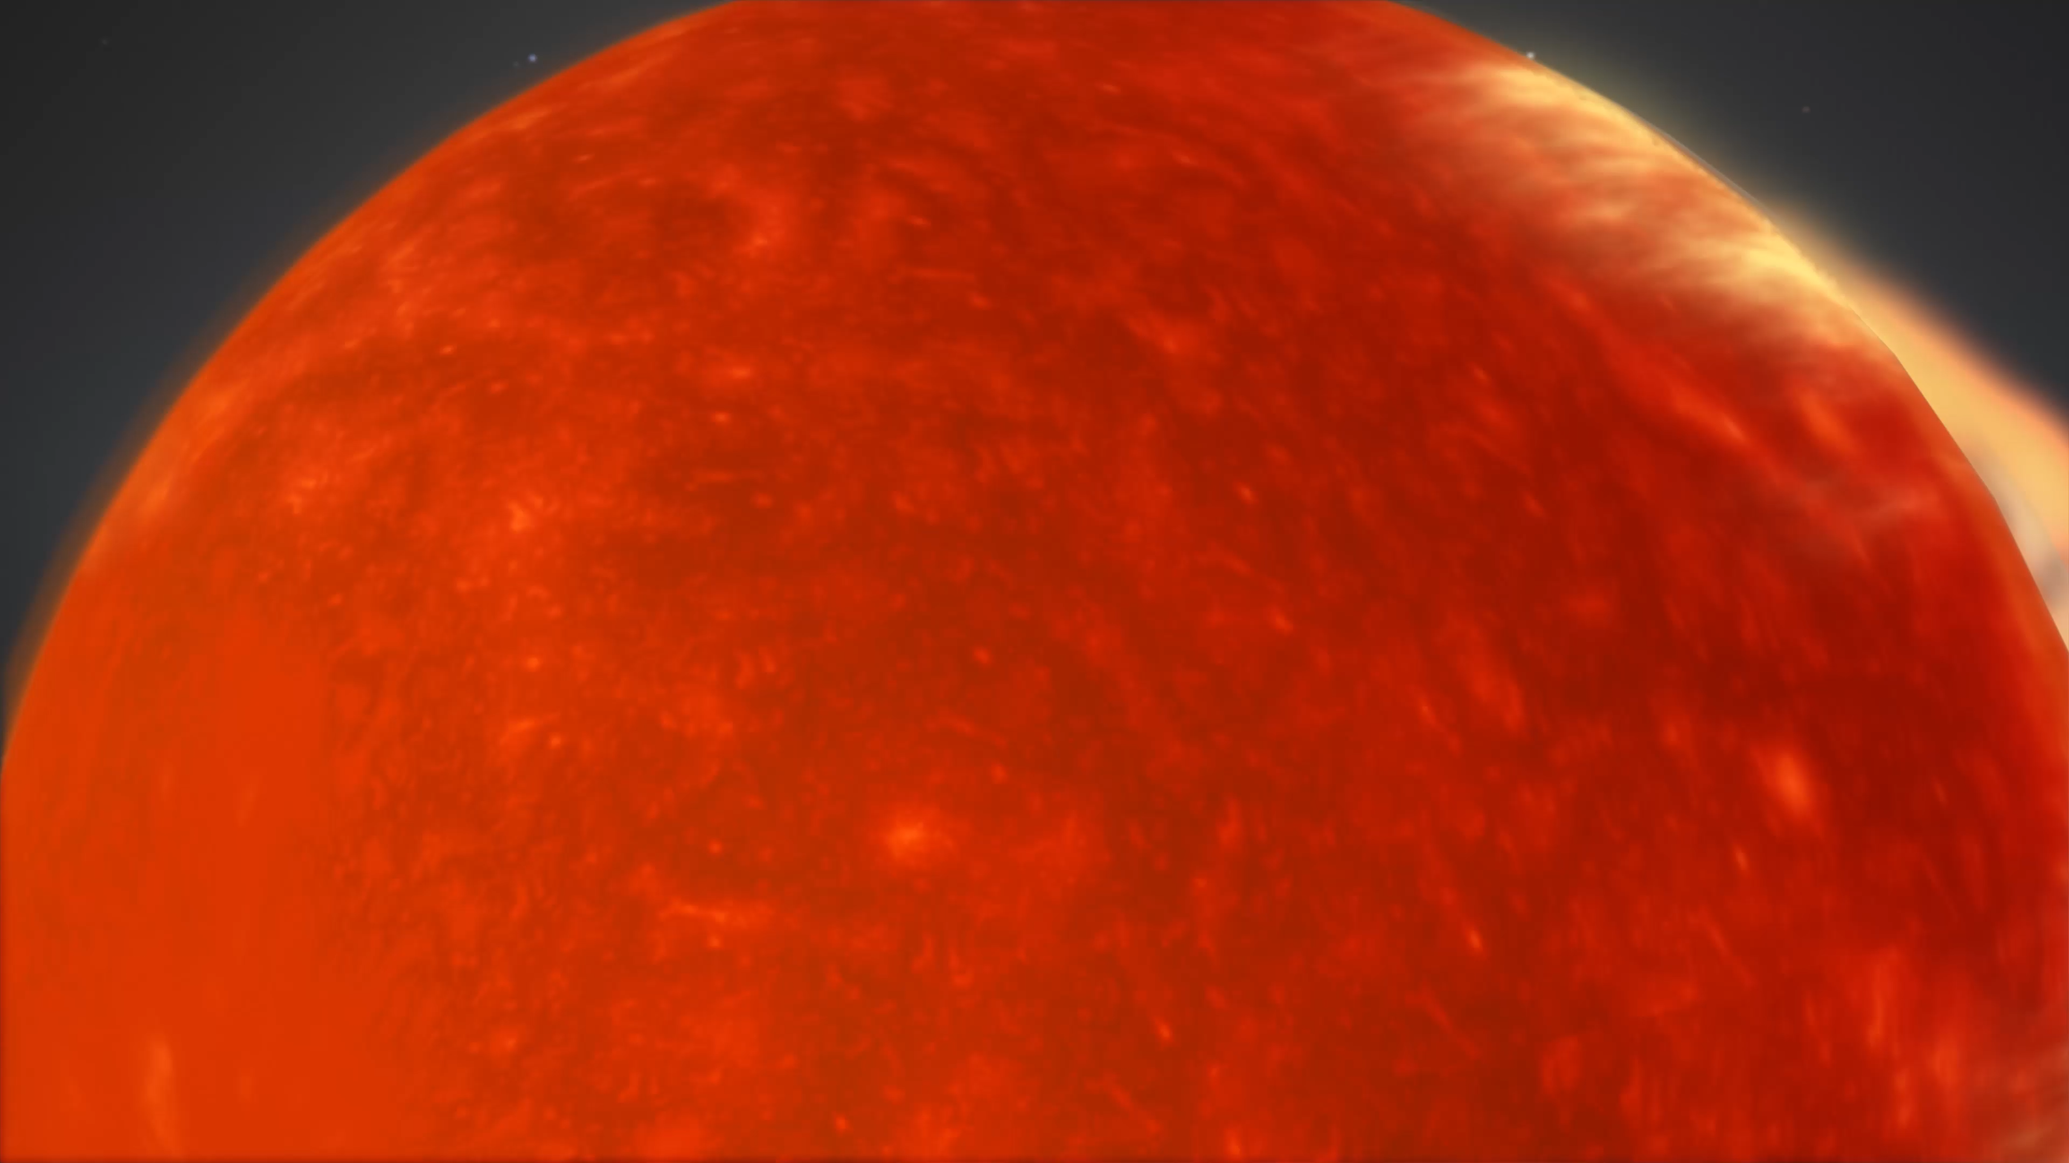
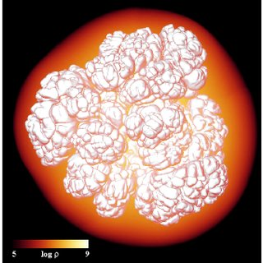
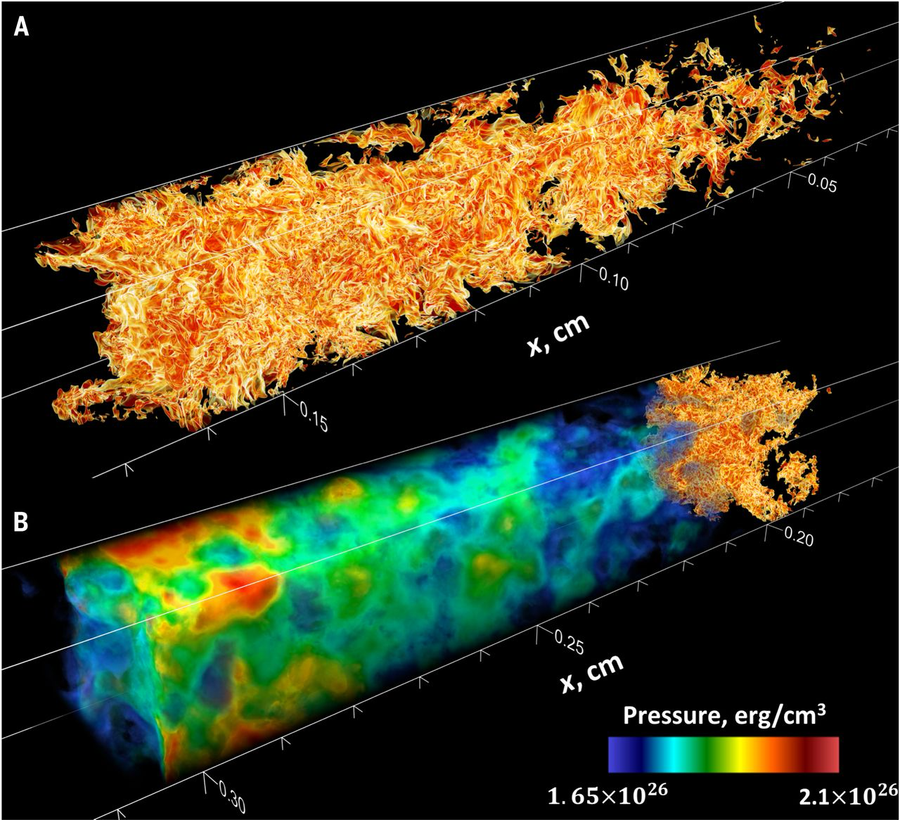
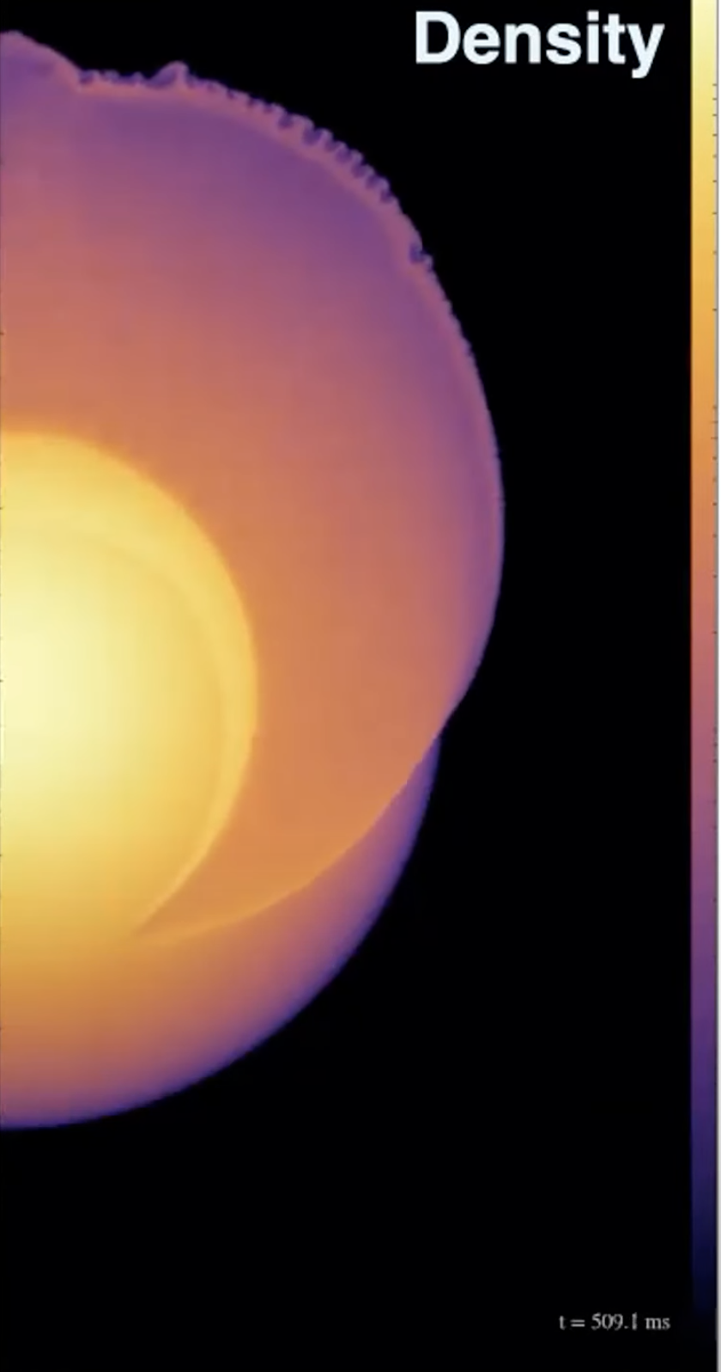
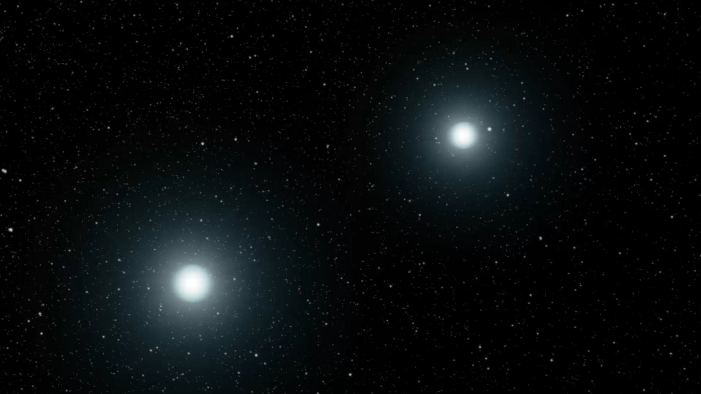
White dwarf supernovae
how does a white dwarf explode?
?
progenitor system
explosion mechanism
Notes:
put double degenerate animation in front

Slide 8


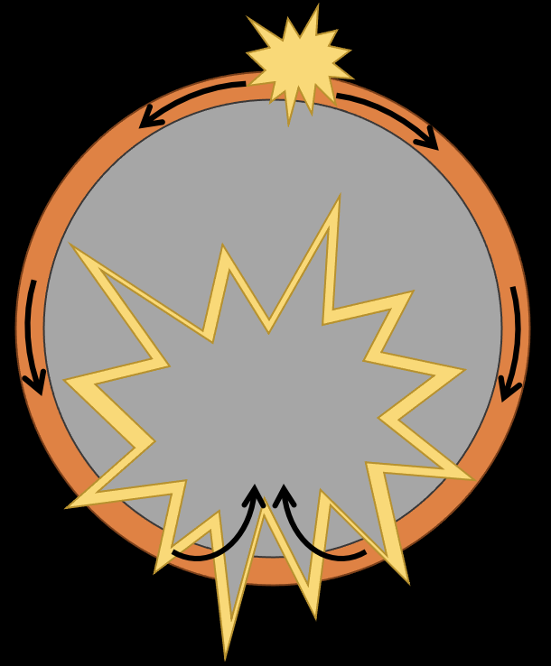
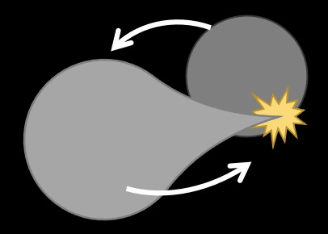
SN IA EXPLOSION MECHANISMS
IGEs: Fe, Co, Ni
IMEs: S, Si, Ar, Ca
LMEs: C, O, Ne, Mg
(supersonic)
(subsonic)
M_{Ch} Detonation
M_{Ch} Deflagration
M_{Ch} Delayed detonation
(sub-to-supersonic)
too much Ni
(too bright)
too little IMEs
layered ejecta
not enough Ni
(too dim)
unburned material
well-mixed ejecta
Deflagration to Detonation Transition (DDT)
layered ejecta
def vs. det regions
Violent WD-WD merger
Sub-M_{Ch} double detonation
detonation of helium shell → detonation of C/O core
asymmetric ejecta
central LMEs
less stable IGEs
layered ejecta
outer layer of He burning ashes
etc.

